Slide 1

Git/GitHub

Slide 2

Agenda
Introduction
What is Git/GitHub
Architecture of Git
More about Git
More about Github

Slide 3

INTRODUCTION
What is GitHub
GitHub is a cloud-based developer platform that allows developers to create, store, manage and share their code.
Storing your code in a "repository" on GitHub allows you to:
Showcase or share your work.
Track and manage changes to your code over time.
Let others review your code, and make suggestions to improve it.
Collaborate on a shared project, without worrying that your changes will impact the work of your collaborators before you're ready to integrate them.
Collaborative working, one of GitHub’s fundamental features, is made possible by the open-source software, Git, upon which GitHub is built.

Slide 4
INTRODUCTION
What is Git
Git is a version control system that intelligently tracks changes in files. Git is particularly useful when you and a group of people are all making changes to the same files at the same time.
Typically, to do this in a Git-based workflow, you would:
Create a branch off from the main copy of files that you (and your collaborators) are working on.
Make edits to the files independently and safely on your own personal branch.
Let Git intelligently merge your specific changes back into the main copy of files, so that your changes don't impact other people's updates.
Let Git keep track of your and other people's changes, so you all stay working on the most up-to-date version of the project.

Slide 5
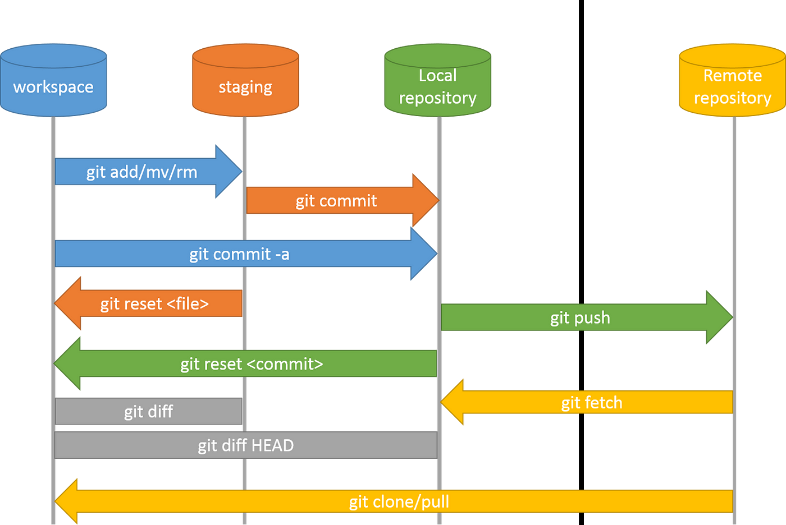
INTRODUCTION
Architecture of Git

Slide 6

Git COMMANDS

Slide 7

Git Commands
Creating a Repository and pushing it to GitHub
Step 1) Create a folder with the files you want to upload.
Step 2) Right click inside the folder and click on Open Git Bash Here.
Step 3) Then enter the below lines in order
git init
git add . [U can replace . which is for all files with the required file name]
git status
git commit -m “First Commit” text.txt
git status
git remote add origin https://github.com/[user-name]/[repo-name.git]
git push –u origin master

Slide 8
Git Commands
git init to create a repository
git clone to copy a remote repository
git add to stage a file
git commit to snapshot the code
git merge to merge/combine branches
git pull to update the repository
git push to share the code
git config --global user.name “user-name”
git config --global user.email “user-email”
git config --list -> to check the details

Slide 9
Git Commands
git remote remove origin -> to remove the origin
git remove set-url origin “required-origin” -> to replace origin
git checkout -b test -> to create a new branch
git checkout master -> to change the branch
git push –set-upstream origin test -> If you are pushing for the first time
git diff -> shows the changes in the file
git branch –d test
git push origin --delete test -> to delete a branch
To merge a branch first go to the branch you want to get merged with and enter git merge branch-you-want-to-merge
git rm file.txt -> to remove a file
git mv file2.txt file3.txt -> merge can be used to rename or move a file

Slide 10

GitHub FEATURES

Slide 11

GitHub Features
Functionality
SSH keys are used to connect to GitHub without supplying your username and personal access token at each visit.
Forks lets you makes changes to a project without affecting the original repository/upstream repository
A fork creates a completely independent copy of git repository. In contrast to a fork, a git clone creates a linked copy that will continue to synchronize with the target repository.
Tags are used to create different version files of your project. To create a tag locally u can do
git tag –a v1.0.0 –m “First Version”
git push origin v1.0.0

Slide 12
THANK YOU

